Slide 1
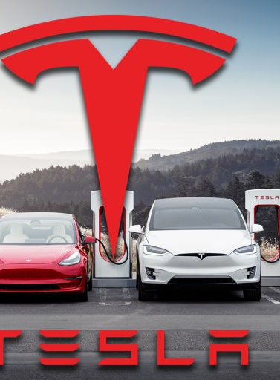
TESLA PERFORMANCE OVER THE YEARS
IN TERMS OF SALES, PRODUCTION AND DELIVERIES
Utkarsh Dubey Jibran Nakhwa Manan Desai

Slide 2
AGENDA
Introduction
Tesla Overview
Possible Problems
Final tips & takeaways

Slide 3
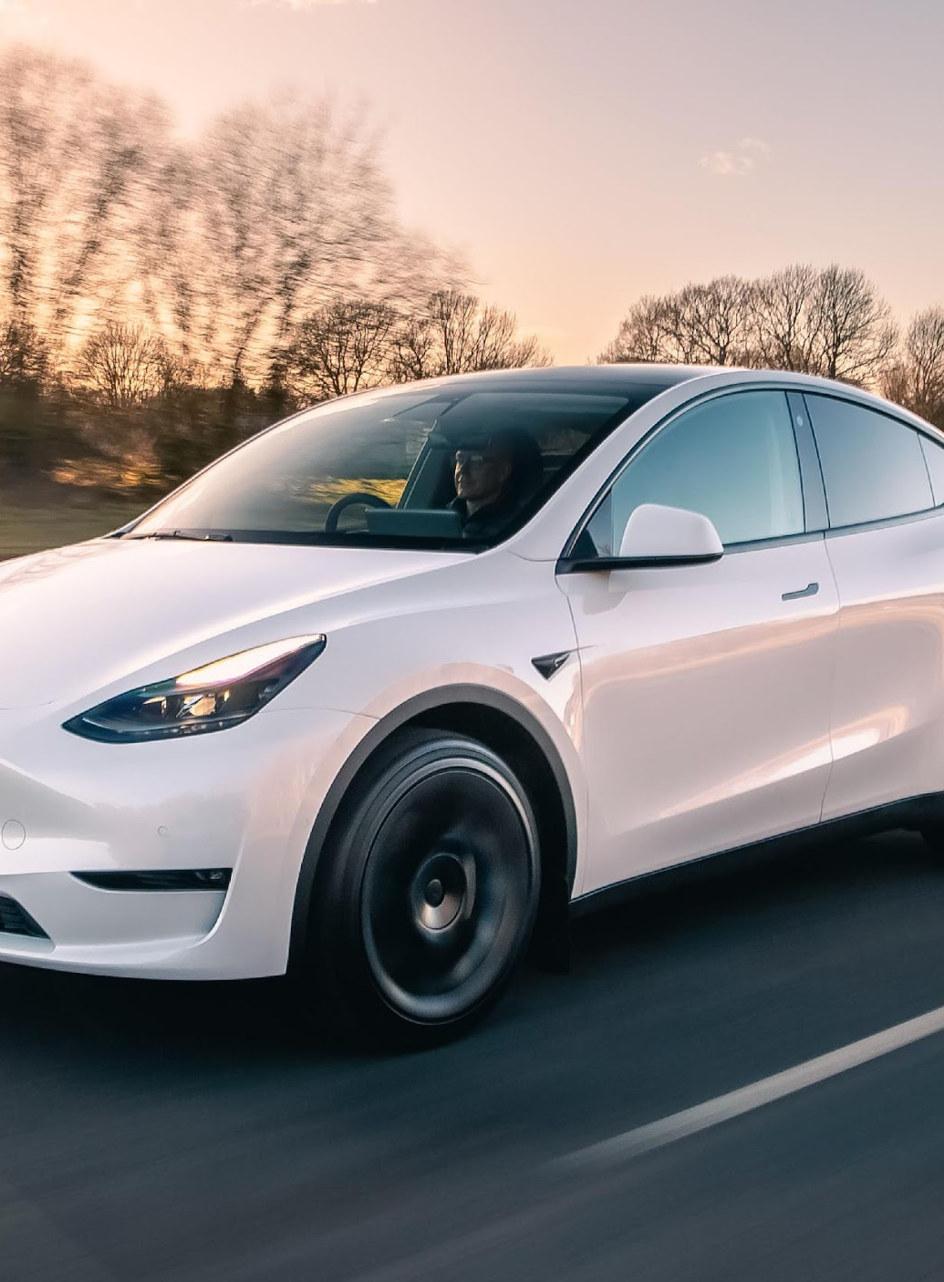
OVERVIEW OF TESLA
Tesla, is an American multinational corporation focused on automotive and sustainable energy solutions.
Tesla stands among the world's most valuable companies by market capitalization.
In October 2021, Tesla briefly achieved a market capitalization of $1 trillion, becoming the sixth U.S. company to reach this milestone.
IN 2023, ranked 69th in Forbes Global 2000.

Slide 4
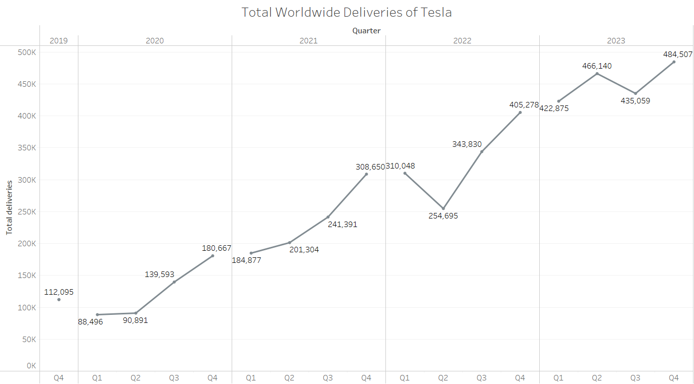
Tesla Delivered over 1.8 million units in 2023 showing 34.78% growth

Slide 5
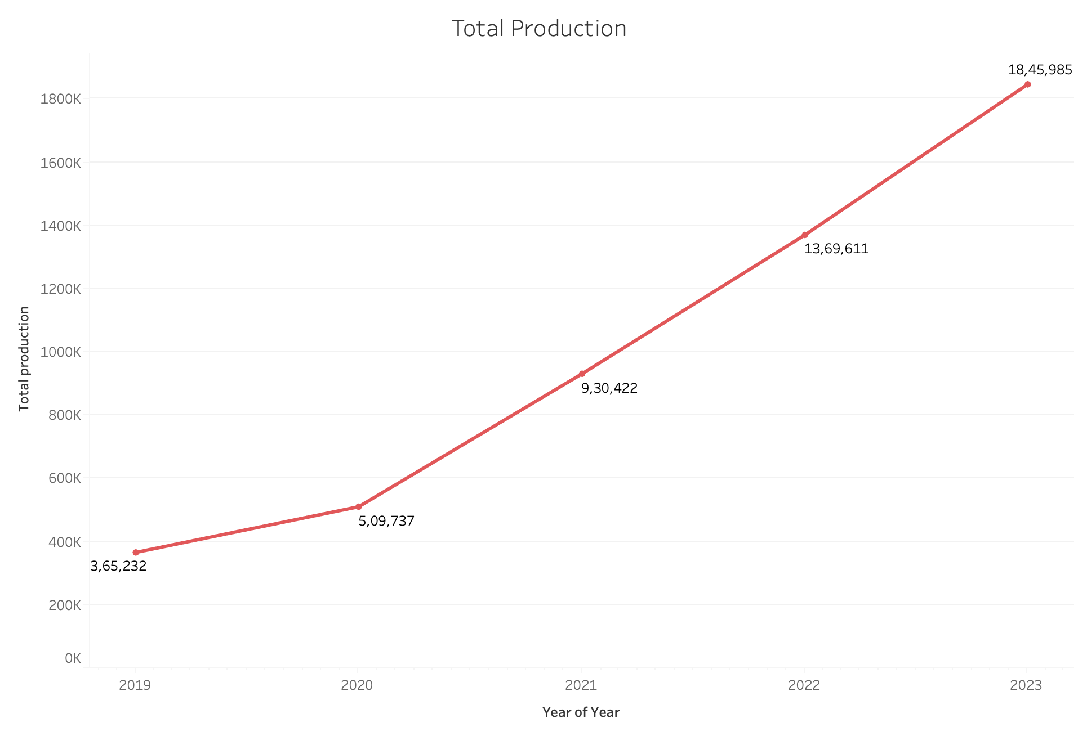
Consistent Growth: Production increased from 365,232 units in 2019 to an estimated 1,845,985 units in 2023, demonstrating robust year-over-year growth.
Accelerated Production Post-2020: The production rate significantly accelerated starting in 2020, suggesting operational improvements and increased demand.
Positive Outlook for 2023: Projected continued growth in 2023 indicates Tesla's strong market confidence and ongoing expansion efforts.

Slide 6
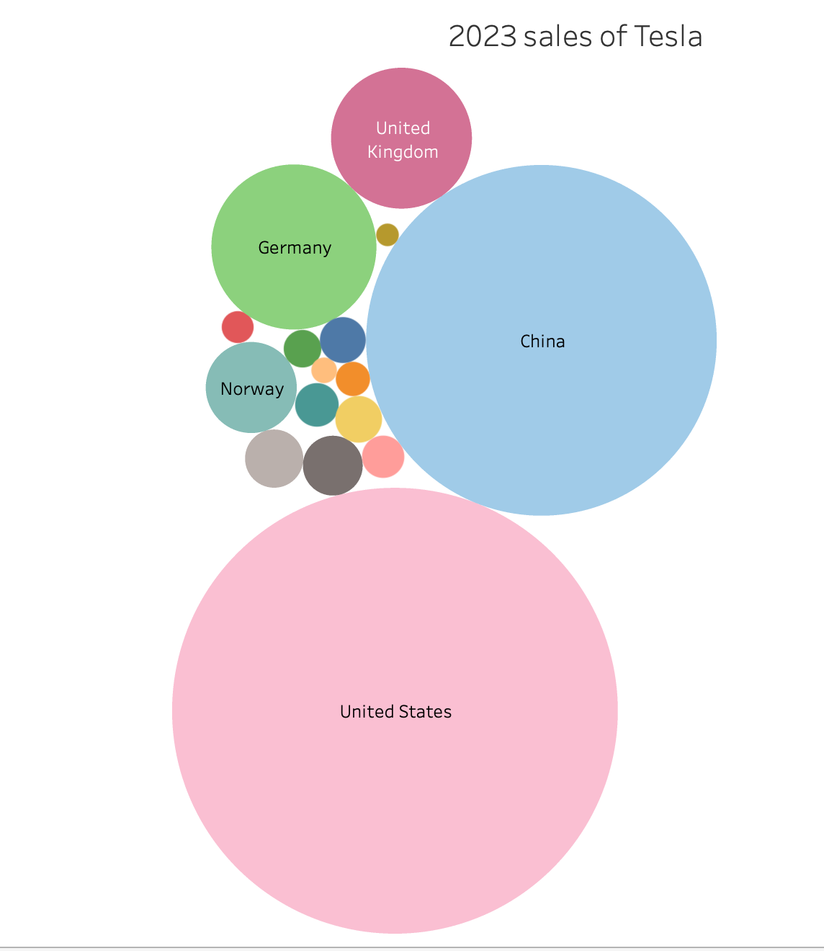
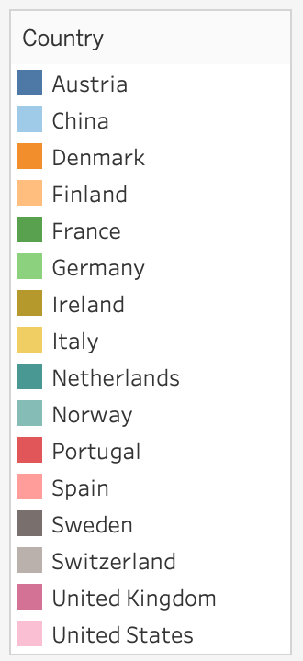

Slide 7
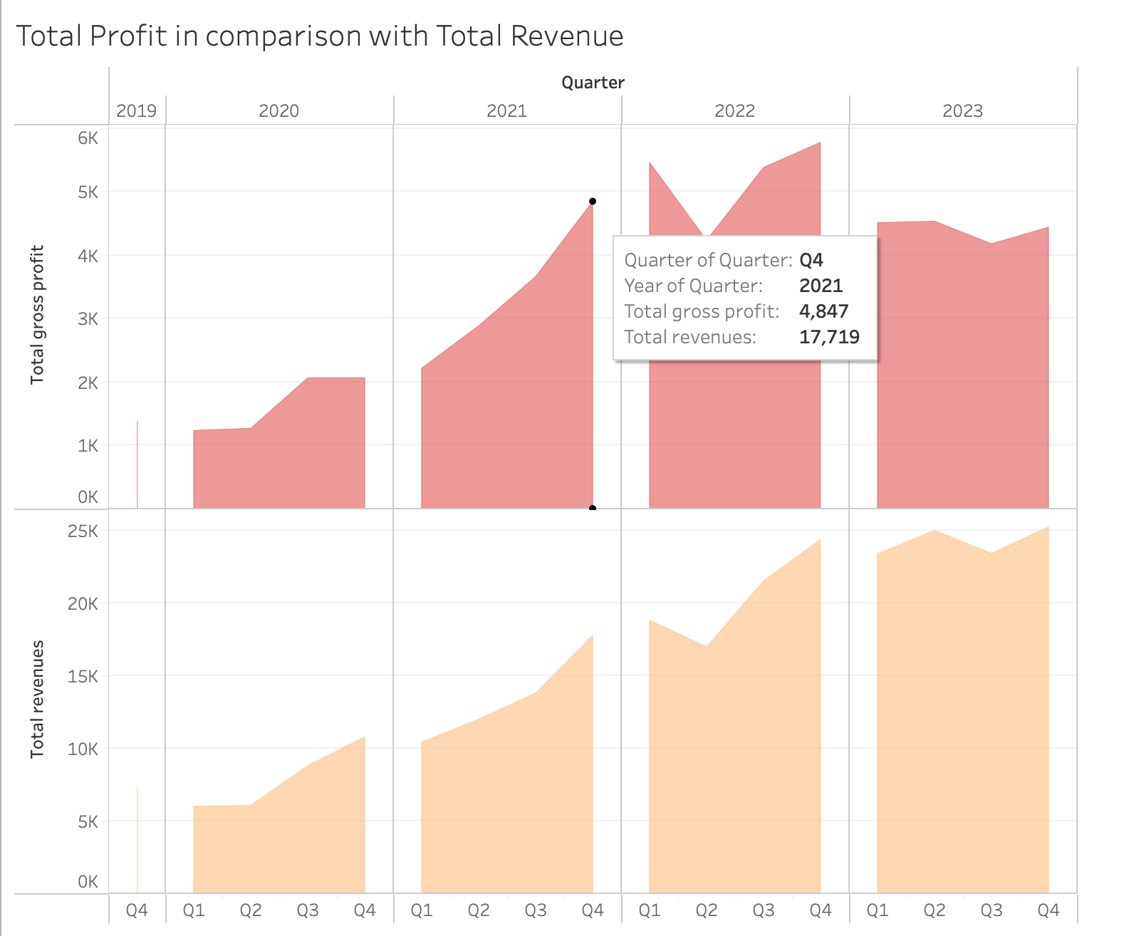
The growth rate of the electric car market in the USA has varied each quarter, with a notable peak in Q3 2022 at 6.10%.
There appears to be a general trend of significant growth within the market, indicating increasing consumer adoption and interest in electric vehicles.
The data underscores the need to capitalize on high-growth quarters and possibly investigate the causes of any fluctuations to better predict future market behaviors.

Slide 8
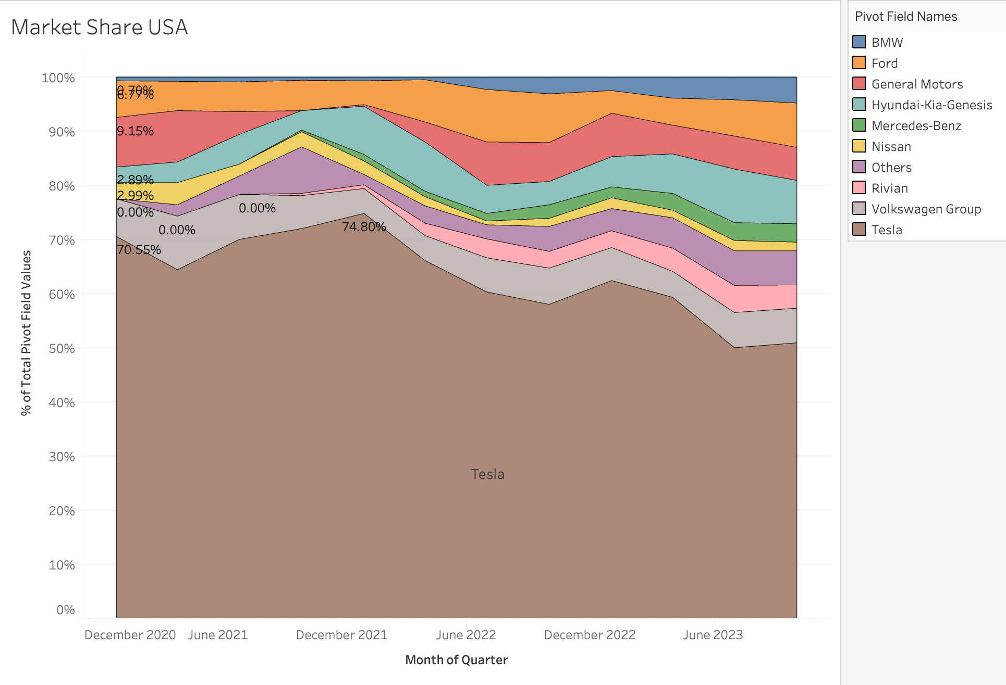
Tesla's Market Leadership: Tesla has consistently held a large majority of the electric vehicle market in the USA.
The fluctuations in market share among competitors, especially any noticeable increases or decreases, indicate changes in consumer preference or the impact of new model releases.
The presence and position of other key players like Ford, General Motors, and new entrants like Rivian, indicating a competitive but heavily skewed market.

Slide 9
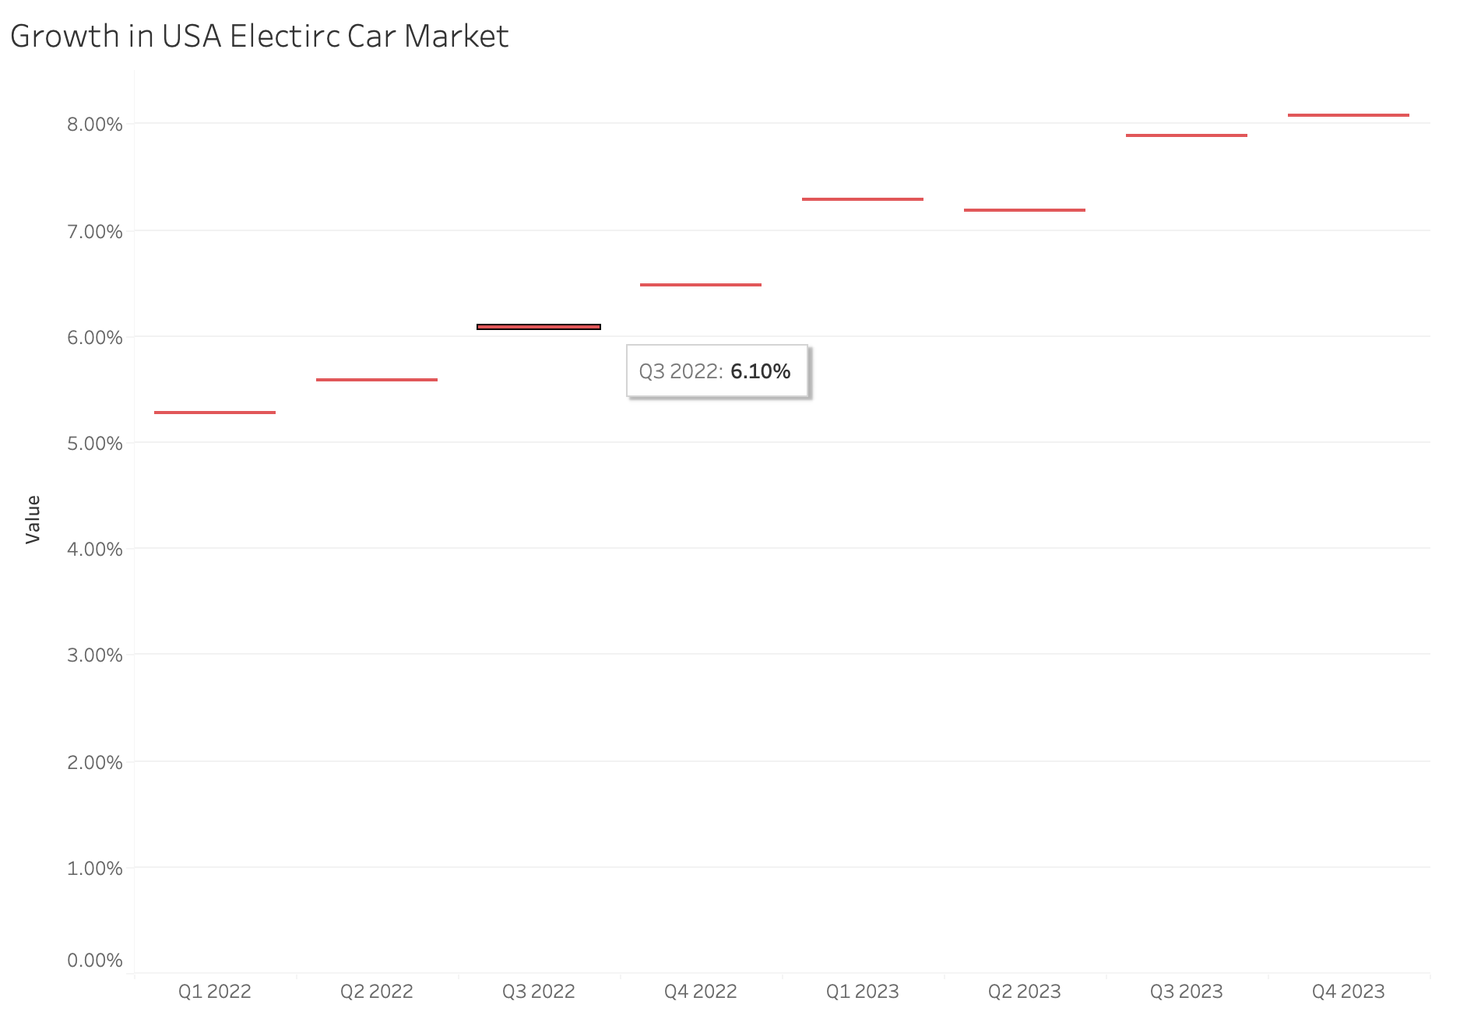
Tesla's Market Leadership: Highlight Tesla's dominant market share, emphasizing that it has consistently held a large majority of the electric vehicle market in the USA.
Trends Over Time: Note the fluctuations in market share among competitors, especially any noticeable increases or decreases, which might indicate changes in consumer preference or the impact of new model releases.
Competitive Landscape: Discuss the presence and position of other key players like Ford, General Motors, and new entrants like Rivian, indicating a competitive but heavily skewed market.
Tesla's Market Leadership: Tesla has consistently held a large majority of the electric vehicle market in the USA.
The fluctuations in market share among competitors, especially any noticeable increases or decreases, indicate changes in consumer preference or the impact of new model releases.
The presence and position of other key players like Ford, General Motors, and new entrants like Rivian, indicating a competitive but heavily skewed market.

Slide 10
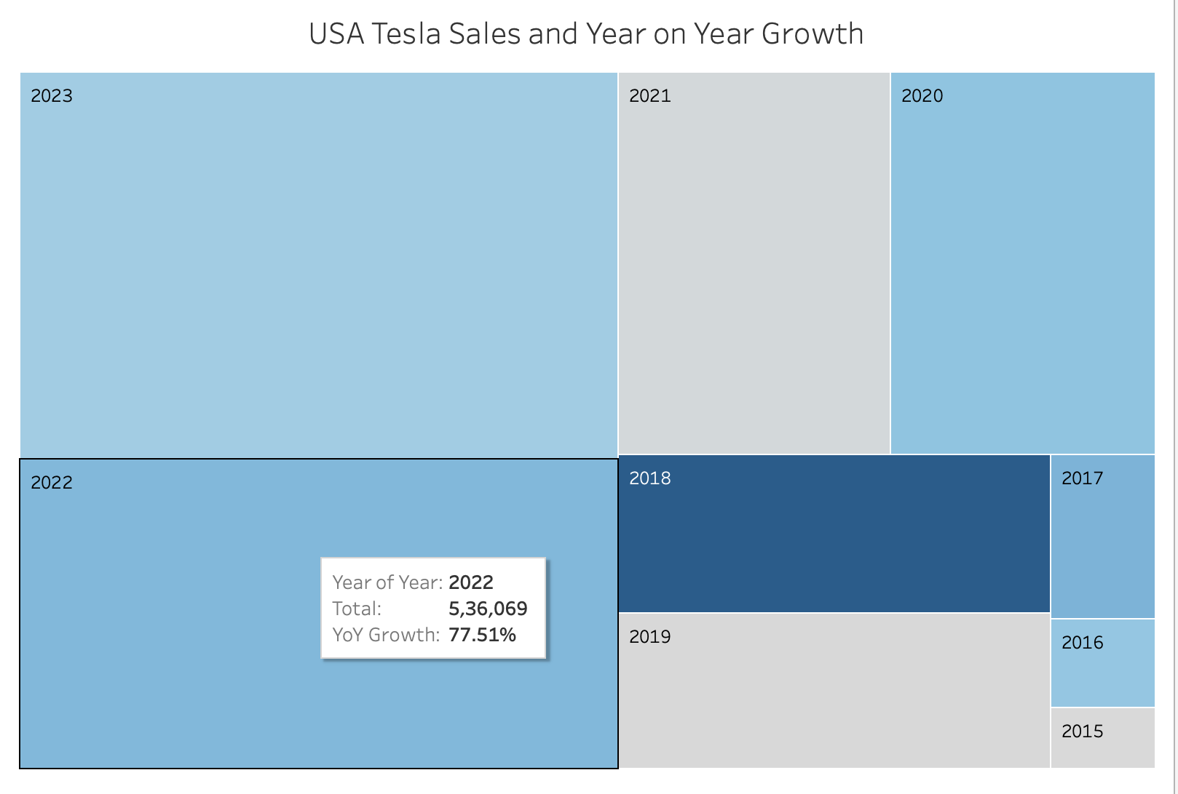
Tesla has a leading sales indicator year by year
Tesla has received over 6 million in Total Sales in 2023 and Yoy Growth of 25 %

Slide 11
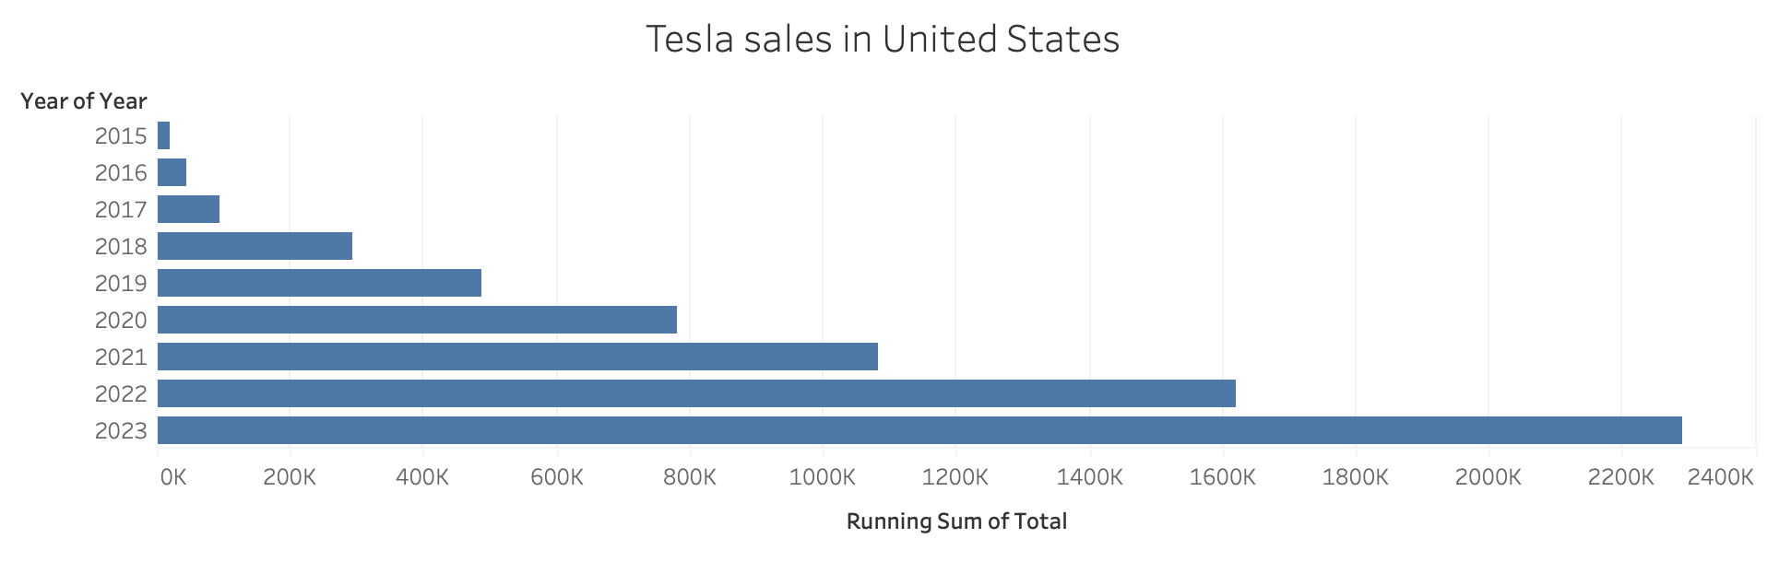

Slide 12
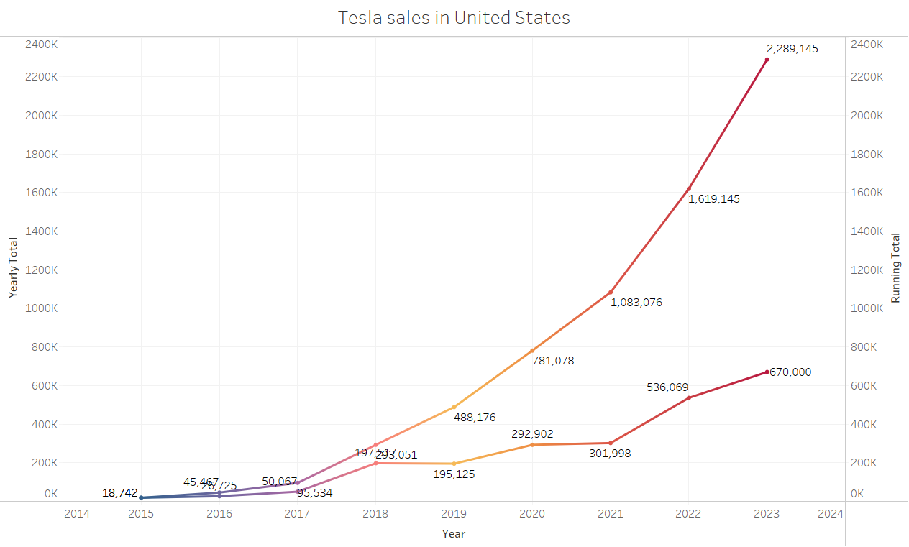
Sales in United States –
Over 2,289,145 vehicles sold till 2023
670,000 + sold in 2023 alone.

Slide 13
POSSIBLE PROBLEMS
ALTHOUGH THE ABOVE SLIDES DEPICT SIGNIFICANT GROWTH, THERE ARE ALSO SOME CONCERNING INDICATORS PRESENT.

Slide 14
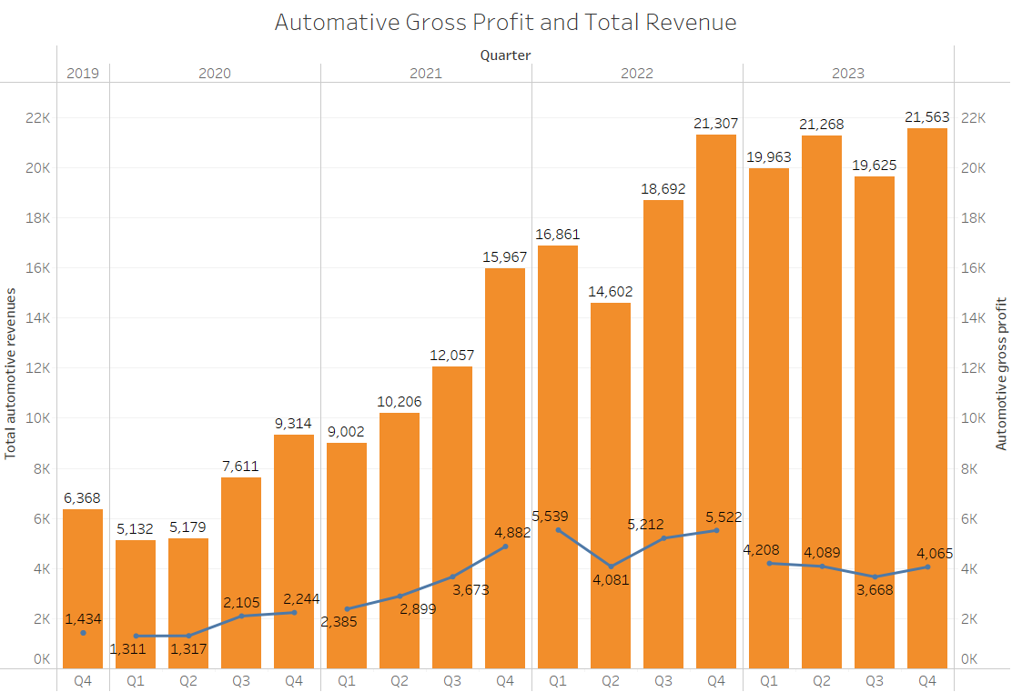
REVENUE AND GROSS PROFIT
Quartly revenue –
2023 saw the lowest Automative gross profit of the last 10 quarters.
Automative Gross Profit for 2023 was 26.974% down than 2022.

Slide 15
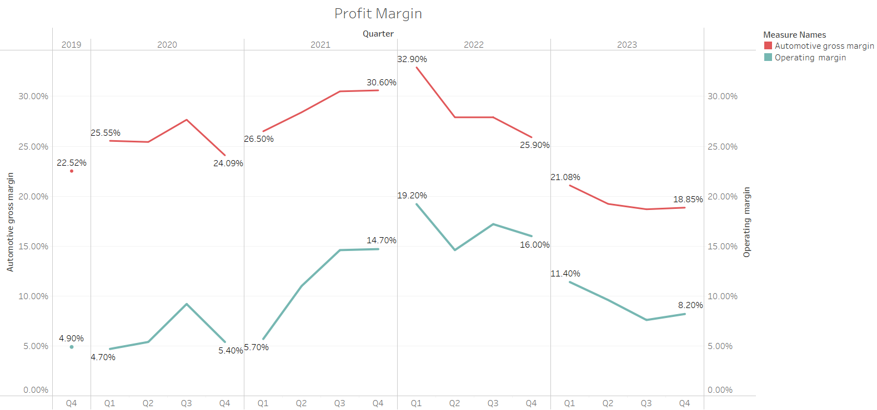
DECREASING PROFIT MARGINS
Profit Margins – Automative profit down to 18.85% in the last quarter of 2023.
Automative gross margin lowest since 2019
Operating Margin also declined to 8.20%.
Automative profit margin and Operating margin falling since Quarter 1 of 2022.

Slide 16
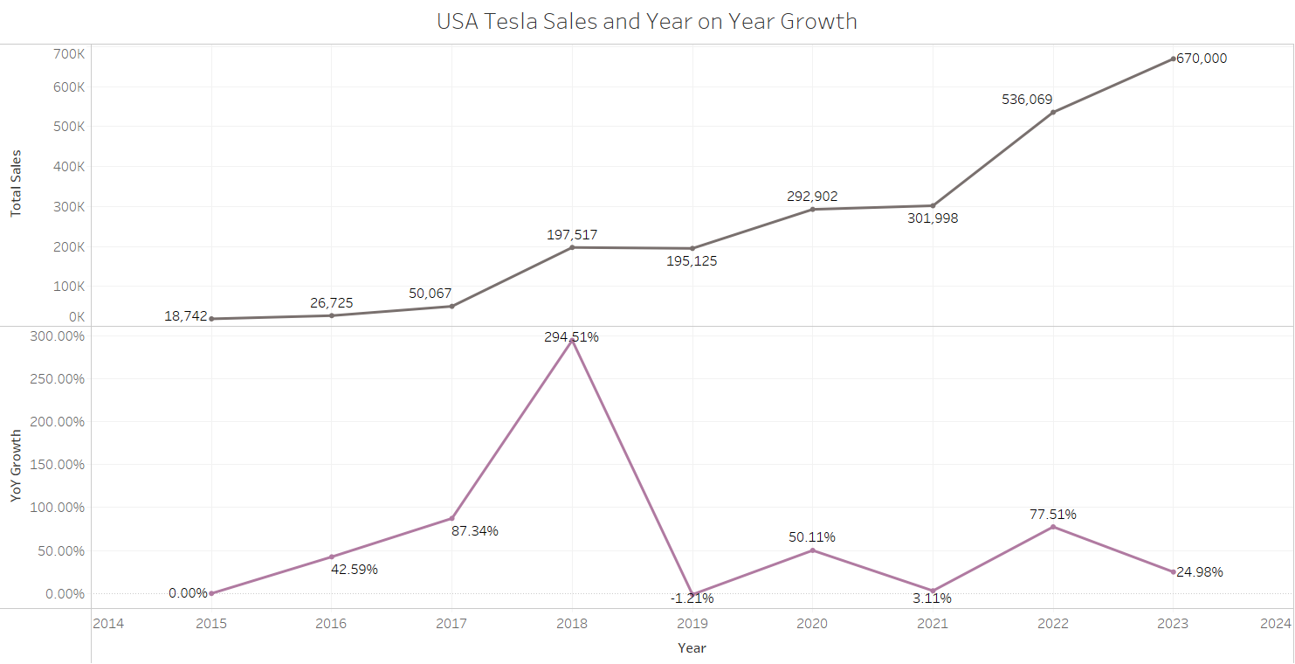
SLOWER GROWTH IN USA
YoY growth declined from 78% to 25% in 2023 in United States.

Slide 17
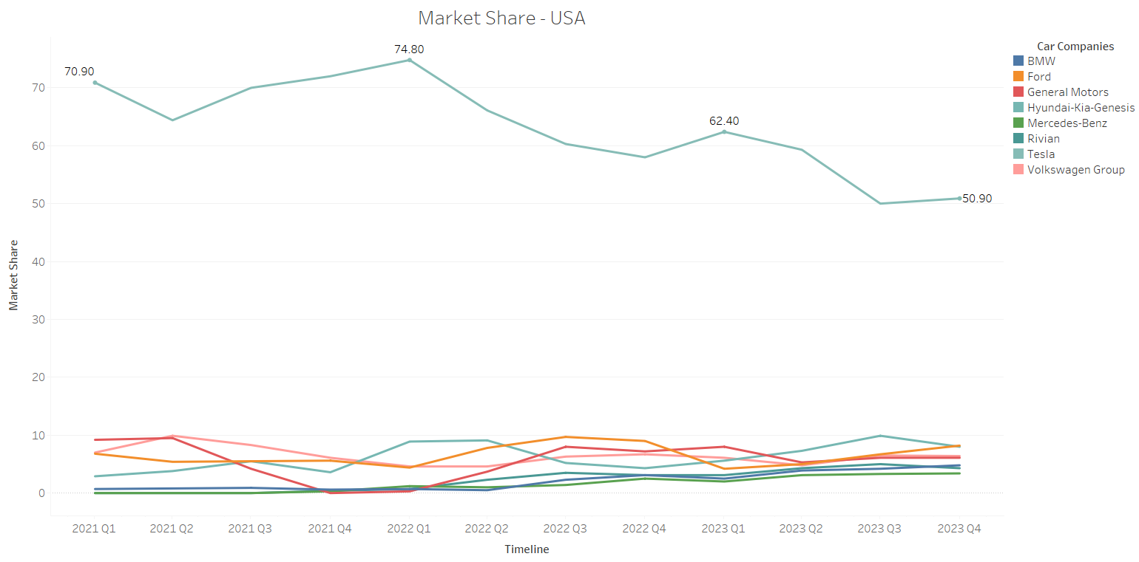
DECREASE IN EV MARKET SHARE IN USA
Tesla Market share dropped to 55.10% from 64.27% in 2023
Seeing a decline of 9.17% in a year in market share.
Whereas companies like Toyota, Genesis, GMC and Lucid saw 666.6%, 283.2%, 279.9% and 122.6% growth from 2022 to 2023 in EV market.

Slide 18
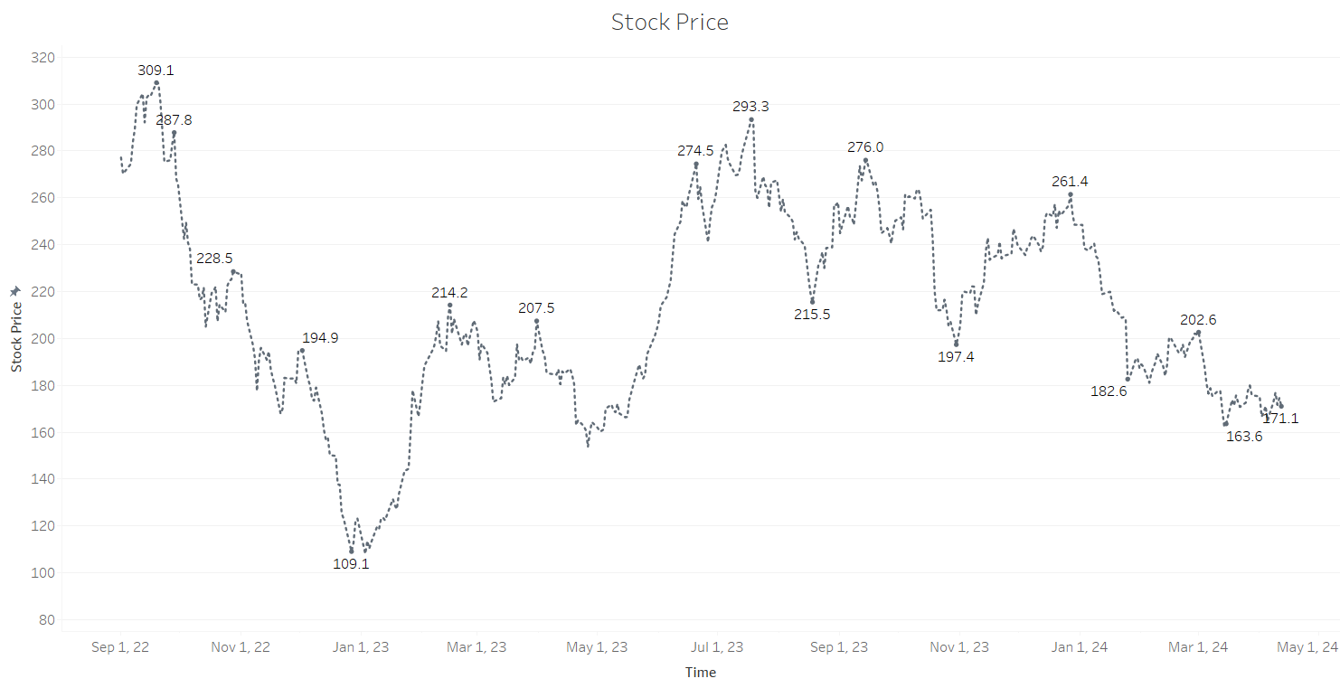
DECLINING STOCK PRICE
Tesla's stock price has fallen 43% YTD(as of 14th April 2023).
Drop of 48% in the last 6 months.

Slide 19
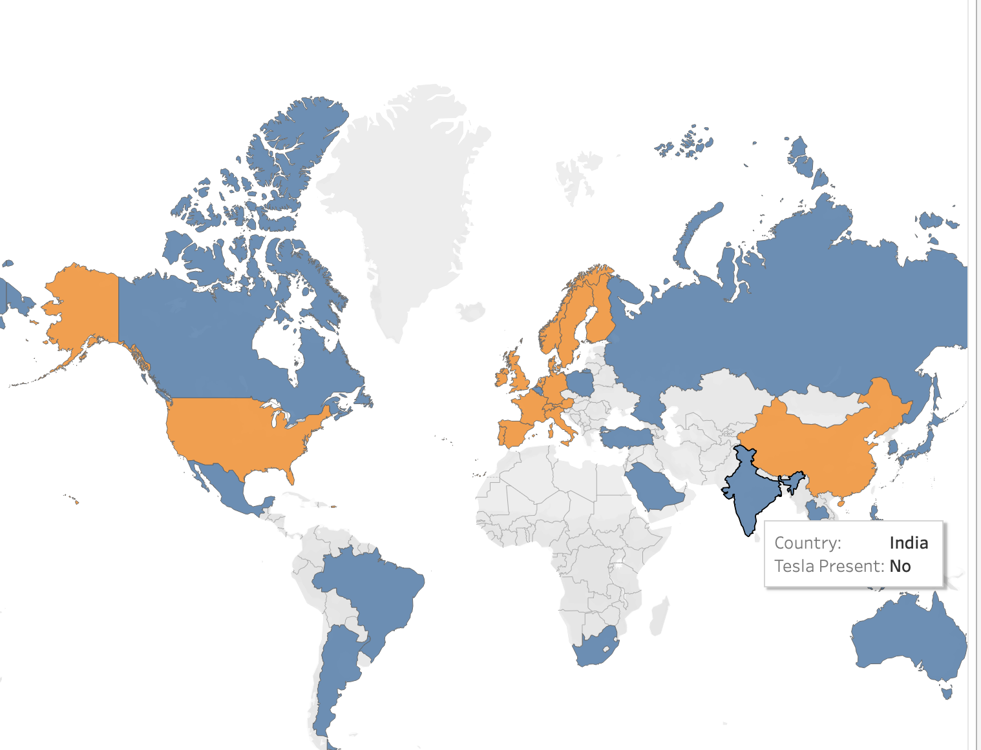
Tesla available in countries

Slide 20
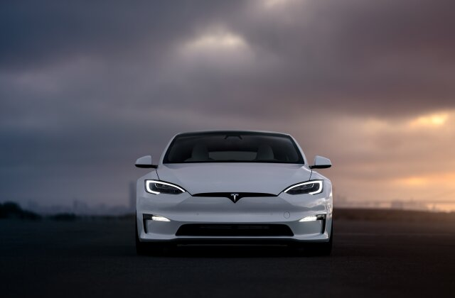
POSSIBLE SOLUTIONS
EXPLORING NEW MARKETS
DEALING WITH COMPETITION
COST BENEFIT ANALYSIS
INVESTING IN CHARGING INFRASTRUCTURE

Slide 21

THANK
YOU !

